Slide 1
Applied Artificial Intelligence / Artificial Intelligence
Machine Learning

Slide 2
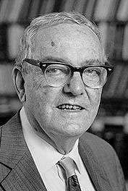
Machine Learning
Herbert Alexander Simon: “Learning is any process by which a system improves performance from experience.”
“Machine Learning is concerned with computer programs that automatically improve their performance through experience. “
Herbert Simon
Turing Award 1975
Nobel Prize in Economics 1978

Slide 3
Why now?
Flood of available data (especially with the advent of the Internet)
Increasing computational power
Growing progress in available algorithms and theory developed by researchers
Increasing support from industries
5

Slide 4
The concept of learning in a ML system
Learning = Improving with experience at some task
Improve over task T,
With respect to performance measure, P
Based on experience, E.
7

Slide 5
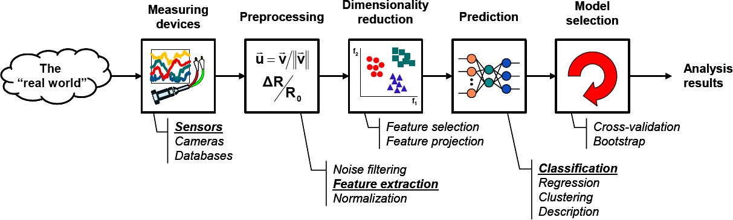
The Learning Process
Model Learning
Model Testing

Slide 6
Machine Learning
Machine Learning is broadly categorized into:
- Supervised Learning (Labeled Data)
- Unsupervised Learning (Unlabeled Data)
Used for different types of problems
7

Slide 7
Supervised Learning
Learns from labeled data.
The model maps inputs to outputs using given examples.
Goal: Minimize error between predictions and actual labels.
Common tasks:
Classification (Spam detection, Image recognition)
Regression (Stock price prediction, House price estimation)

Slide 8
Unsupervised Learning
Learns from unlabeled data.
Finds patterns, structures, or groupings in data.
Common tasks:
Clustering (Customer segmentation, Anomaly detection)
Dimensionality Reduction (PCA, t-SNE for visualization)

Slide 9
Regression vs Classification
 | Regression | Classification
Goal | Predict continuous values | Predict discrete labels
Output Type | Continuous (Real numbers) | Categorical (Classes/Labels)
Examples | House price prediction, Temperature forecasting | Spam detection, Disease diagnosis
Algorithms | Linear Regression, Neural Networks | Logistic Regression, Naïve Bayes, Neural Networks

Slide 10
Supervised Learning – Naïve Bayes
DAY | OUTLOOK | TEMP | HUMIDITY | WIND | PLAY
D1 | Sunny | Hot | High | Weak | No
D2 | Sunny | Hot | High | Strong | No
D3 | Overcast | Hot | High | Weak | Yes
D4 | Rain | Mild | High | Weak | Yes
D5 | Rain | Cool | Normal | Weak | Yes
D6 | Rain | Cool | Normal | Strong | No
D7 | Overcast | Cool | Normal | Strong | Yes
D8 | Sunny | Mild | High | Weak | No
D9 | Sunny | Cool | Normal | Weak | Yes
D10 | Rain | Mild | Normal | Weak | Yes
D11 | Sunny | Mild | Normal | Strong | Yes
D12 | Overcast | Mild | High | Strong | Yes
D13 | Overcast | Hot | Normal | Weak | Yes
D14 | Rain | Mild | High | Strong | No

Slide 11
Naïve Bayes Classification
Step#1: Total Rows = 14
Total YES = 9 | Total NO = 5
Probability (YES) = 9/14 | Probability (NO) = 5/14
Step#2: Make a table for every attribute. (4 attributes, 4 tables)
Attribute: Outlook
 | YES | NO
Sunny | 2/9 | 3/5
Overcast | 4/9 | 0/5
Rain | 3/9 | 2/5
Total | 9/9 | 5/5
Attribute: Temperature
 | YES | NO
Hot | 2/9 | 2/5
Mild | 4/9 | 2/5
Cool | 3/9 | 1/5
Total | 9/9 | 5/5
Attribute: Humidity
 | YES | NO
High | 3/9 | 4/5
Normal | 6/9 | 1/5
Total | 9/9 | 5/5
Attribute: Wind
 | YES | NO
Strong | 3/9 | 3/5
Weak | 6/9 | 2/5
Total | 9/9 | 5/5

Slide 12
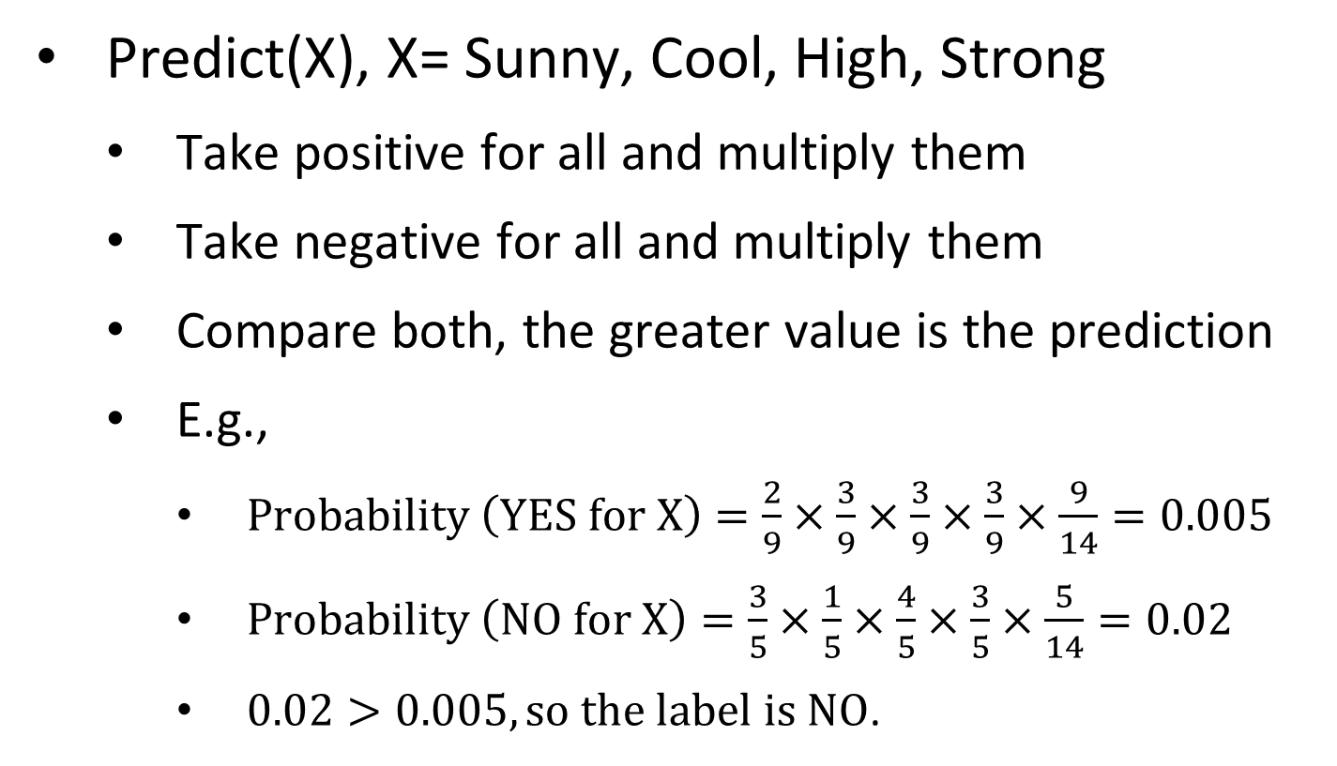
Naïve Bayes Classification
Predict(X), X= Sunny, Cool, High, Strong
Take positive for all and multiply them
Take negative for all and multiply them
Compare both, the greater value is the prediction
E.g.,
$\text{Probability} \left(\text{YES} \text{for} \text{X}\right)=\frac{2}{9}×\frac{3}{9}×\frac{3}{9}×\frac{3}{9}×\frac{9}{14}=0.005$
$\text{Probability} \left(\text{NO} \text{for} \text{X}\right)=\frac{3}{5}×\frac{1}{5}×\frac{4}{5}×\frac{3}{5}×\frac{5}{14}=0.02$
$0.02>0.005, \text{so} \text{the} \text{label} \text{is} \text{NO}$.

Slide 13
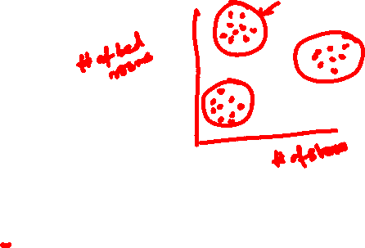
Unsupervised Learning
K-means Clustering

Slide 14
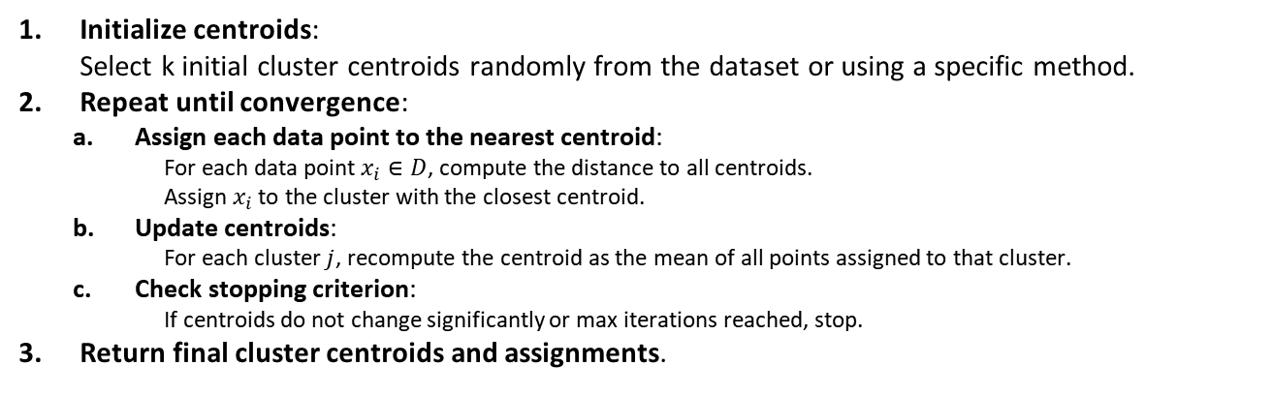

K-means Clustering
Input:
A dataset D with n data points
Number of clusters k
A distance metric (e.g., Euclidean distance)
A stopping criterion (e.g., convergence of centroids or max iterations)
Output:
k cluster centroids
Cluster assignments for each data point
Initialize centroids: Select k initial cluster centroids randomly from the dataset or using a specific method.
Repeat until convergence:
Assign each data point to the nearest centroid:
For each data point $x_{i}∈D$, compute the distance to all centroids.
Assign $x_{i}$ to the cluster with the closest centroid.
Update centroids:
For each cluster $j$, recompute the centroid as the mean of all points assigned to that cluster.
Check stopping criterion:
If centroids do not change significantly or max iterations reached, stop.
Return final cluster centroids and assignments.

Slide 15

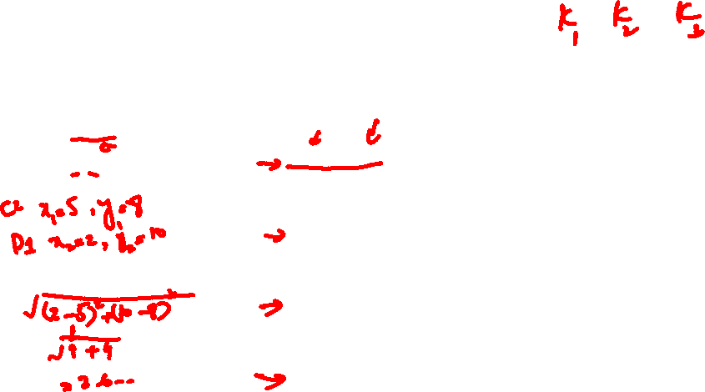
K-means Clustering - Example
Centroids
C₁: (2, 10)
C₂: (5, 8)
C₃: (1, 2)
Datapoints |  |  | Distance to Centroid |  |  | Cluster
 |  |  | C₁ | C₂ | C₃
D1 | 2 | 10
D2 | 2 | 5
D3 | 8 | 4
D4 | 5 | 8
D5 | 7 | 5
D6 | 6 | 4
D7 | 1 | 2
D8 | 4 | 9
$$d\left(p_{1}, p_{2}\right)=\sqrt{{\left(x_{2}−x_{1}\right)}^{2}+{\left(y_{2}−y_{1}\right)}^{2}}$$

Slide 16
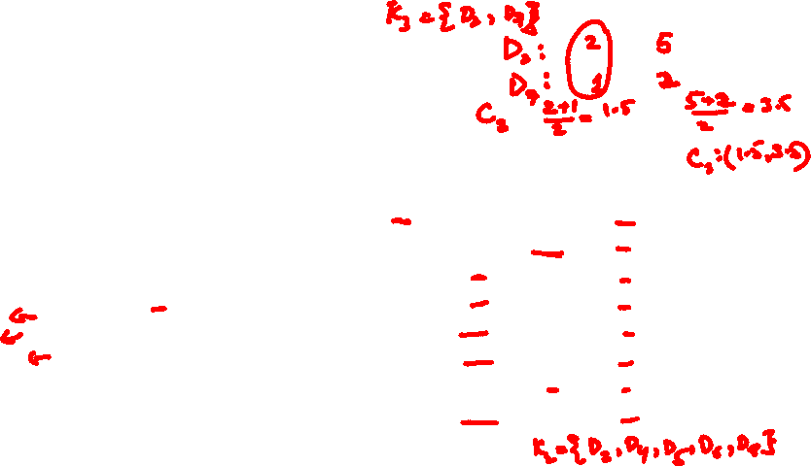
K-means Clustering - Example
Centroids
C₁: (2, 10)
C₂: (5, 8)
C₃: (1, 2)
Datapoints |  |  | Distance to Centroid |  |  | Cluster
 |  |  | C₁ | C₂ | C₃
D1 | 2 | 10 | 0 | 3.61 | 8.06 | 1
D2 | 2 | 5 | 5 | 4.24 | 3.16 | 3
D3 | 8 | 4 | 8.49 | 5 | 7.28 | 2
D4 | 5 | 8 | 3.61 | 0 | 7.21 | 2
D5 | 7 | 5 | 7.07 | 3.61 | 6.71 | 2
D6 | 6 | 4 | 7.21 | 4.12 | 5.39 | 2
D7 | 1 | 2 | 8.06 | 7.21 | 0 | 3
D8 | 4 | 9 | 2.24 | 1.41 | 7.62 | 2
New Centroids
C₁: (2, 10)
C₂: (6, 6)
C₃: (1.5, 3.5)
$$d\left(p_{1}, p_{2}\right)=\sqrt{{\left(x_{2}−x_{1}\right)}^{2}+{\left(y_{2}−y_{1}\right)}^{2}}$$

Slide 17
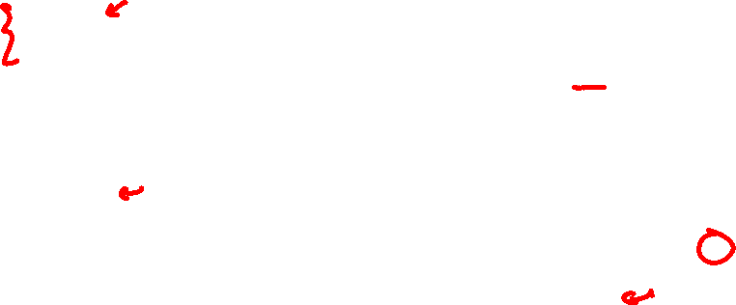
K-means Clustering - Example
Centroids
C₁: (2, 10)
C₂: (6, 6)
C₃: (1.5, 3.5)
Datapoints |  |  | Distance to Centroid |  |  | Old Cluster | New Cluster
 |  |  | C₁ | C₂ | C₃
D1 | 2 | 10 | 0 | 5.66 | 6.52 | 1 | 1
D2 | 2 | 5 | 5 | 4.12 | 1.58 | 3 | 3
D3 | 8 | 4 | 8.49 | 2.83 | 6.52 | 2 | 2
D4 | 5 | 8 | 3.61 | 2.24 | 5.70 | 2 | 2
D5 | 7 | 5 | 7.07 | 1.41 | 5.70 | 2 | 2
D6 | 6 | 4 | 7.21 | 2 | 4.53 | 2 | 2
D7 | 1 | 2 | 8.06 | 6.40 | 1.58 | 3 | 3
D8 | 4 | 9 | 2.24 | 3.61 | 6.04 | 2 | 1
New Centroids
C₁: (3, 9.5)
C₂: (6.5, 5.25)
C₃: (1.5, 3.5)
$$d\left(p_{1}, p_{2}\right)=\sqrt{{\left(x_{2}−x_{1}\right)}^{2}+{\left(y_{2}−y_{1}\right)}^{2}}$$

Slide 18
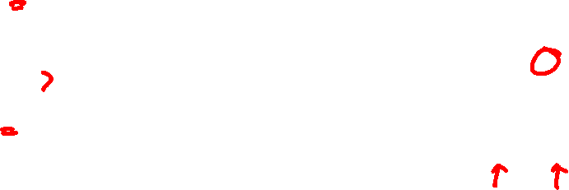
K-means Clustering - Example
Centroids
C₁: (3, 9.5)
C₂: (6.5, 5.25)
C₃: (1.5, 3.5)
Datapoints |  |  | Distance to Centroid |  |  | Old Cluster | New Cluster
 |  |  | C₁ | C₂ | C₃
D1 | 2 | 10 | 1.12 | 6.54 | 6.52 | 1 | 1
D2 | 2 | 5 | 4.61 | 4.51 | 1.58 | 3 | 3
D3 | 8 | 4 | 7.43 | 1.95 | 6.52 | 2 | 2
D4 | 5 | 8 | 2.50 | 3.13 | 5.70 | 2 | 1
D5 | 7 | 5 | 6.02 | 0.56 | 5.70 | 2 | 2
D6 | 6 | 4 | 6.26 | 1.35 | 4.53 | 2 | 2
D7 | 1 | 2 | 7.76 | 6.39 | 1.58 | 3 | 3
D8 | 4 | 9 | 1.12 | 4.51 | 6.04 | 1 | 1
New Centroids
C₁: (3.67, 9)
C₂: (7, 4.33)
C₃: (1.5, 3.5)
$$d\left(p_{1}, p_{2}\right)=\sqrt{{\left(x_{2}−x_{1}\right)}^{2}+{\left(y_{2}−y_{1}\right)}^{2}}$$

Slide 19
K-means Clustering - Example
Centroids
C₁: (3.67, 9)
C₂: (7, 4.33)
C₃: (1.5, 3.5)
Datapoints |  |  | Distance to Centroid |  |  | Old Cluster | New Cluster
 |  |  | C₁ | C₂ | C₃
D1 | 2 | 10 | 1.94 | 7.56 | 6.52 | 1 | 1
D2 | 2 | 5 | 4.33 | 5.04 | 1.58 | 3 | 3
D3 | 8 | 4 | 6.62 | 1.05 | 6.52 | 2 | 2
D4 | 5 | 8 | 1.67 | 4.18 | 5.70 | 1 | 1
D5 | 7 | 5 | 5.21 | 0.67 | 5.70 | 2 | 2
D6 | 6 | 4 | 5.52 | 1.05 | 4.53 | 2 | 2
D7 | 1 | 2 | 7.49 | 6.44 | 1.58 | 3 | 3
D8 | 4 | 9 | 0.33 | 5.55 | 6.04 | 1 | 1
$$d\left(p_{1}, p_{2}\right)=\sqrt{{\left(x_{2}−x_{1}\right)}^{2}+{\left(y_{2}−y_{1}\right)}^{2}}$$

